Slide 1

LINUX Fundamentals

Slide 2
All About “UNIX”

Slide 3
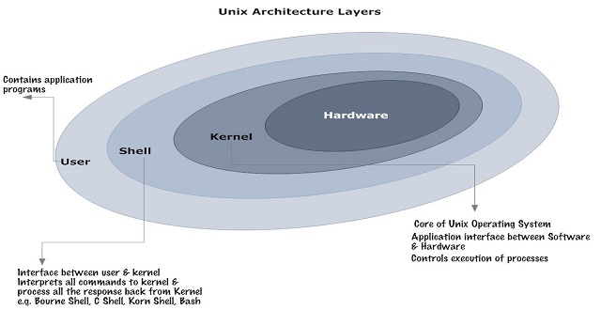
Basics & History of UNIX
History of UNIX® dates back to 1969.It has developed and evolved through a number of different versions and environments. Most modern UNIX variants known today are licensed versions of one of the original UNIX editions. Sun's Solaris, Hewlett-Packard's HP-UX, and IBM's AIX® are all flavors of UNIX that have their own unique elements and foundations.
Basic structure of Unix operating system

Slide 4
Key Features and General Characteristics
Multitasking && Multiuser : Most versions of UNIX allows multiple users to log onto the system & each run multiple tasks. This is standard for most modern OS.
Free Applications and Even a Free Operating System : OFF all of the applications available under UNIX, many of them are free. The compilers and interpreters that we use in most of the programming courses here at UMBC can be downloaded free of charge. Most of the development that we do in programming courses is done under the Linux OS.
Less Resource Intensive : UNIX installations tend to be much less demanding on system resources. In many cases, the old family computer that can barely run Windows is more than sufficient to run the latest version of Linux.

Slide 5
Talking about linux
Linux is a generic term referring to Unix-like graphical user interface (GUI) based computer operating systems.
Powerful -
Runs on multiple hardware platforms
Users like its speed and stability
No requirement for latest hardware.
Linux is an operating system kernel, and UNIX is a certification for operating systems..

Slide 6
Some glimpse about Linux
A fully-networked 32/64-Bit Unix-like Operating System.
Multi-user, Multitasking, Multiprocessor
Has the X Windows GUI
Coexists with other Operating Systems
Runs on multiple platforms
Includes the Source Code

Slide 7
Installing UBUNTU <LINUX VERSION>

Slide 8
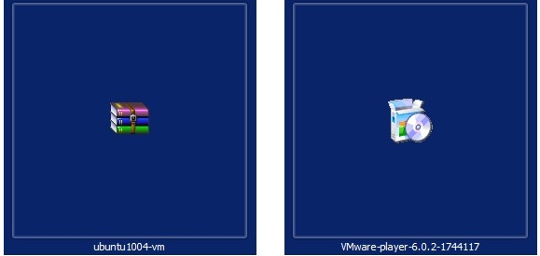
Before Installing
We need the following things before keeping hands on The UNIX like environment , i.e. through Ubuntu
Ubuntu image for VMware
VMware player for running Ubuntu.

Slide 9
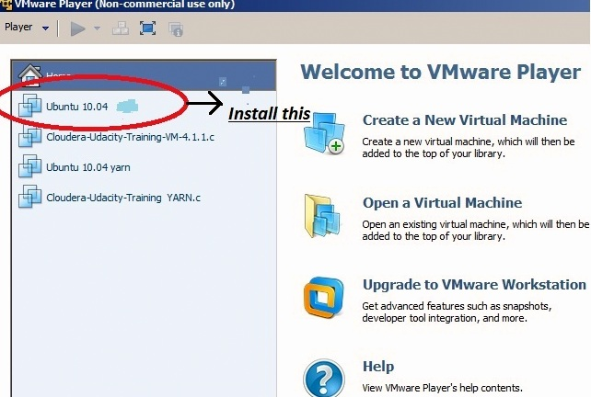
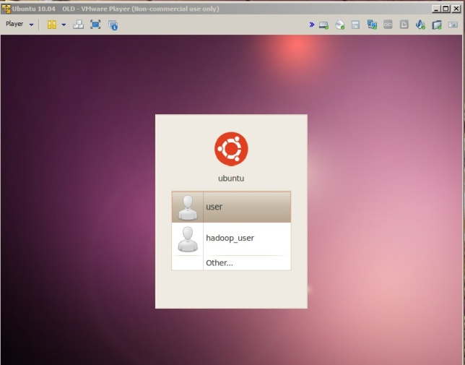

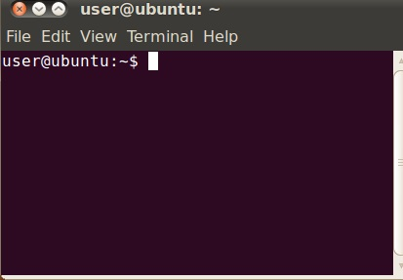
Installing UBUNTU….
1ST Install VMware and then install UBUNTU on it .
Terminal : Place where commands are written…
Terminal shows the name of current logged in user and that particular user can make changes in his Environment only as in windows..

Slide 10
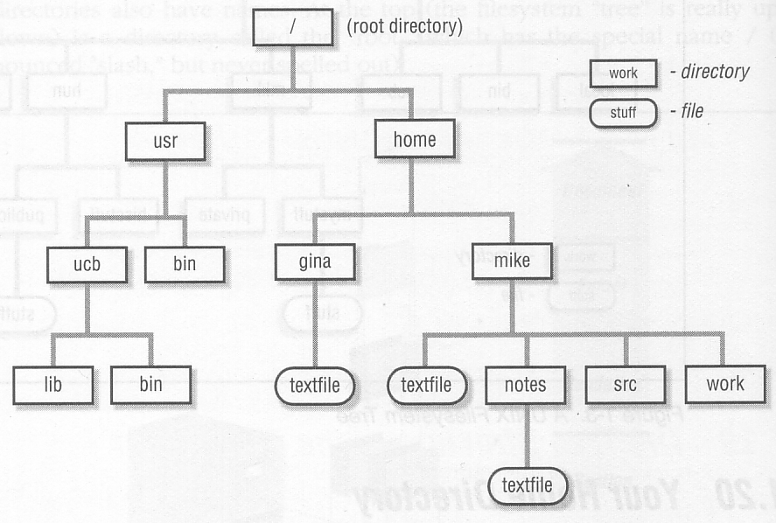
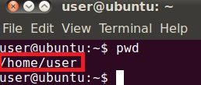
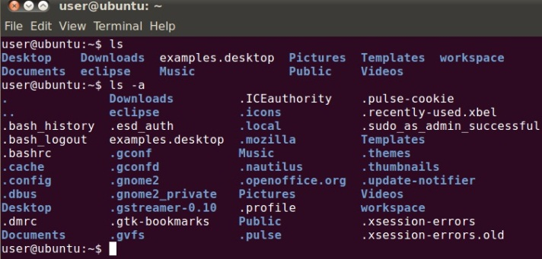
LINUX Structure & some basic commands
/symbolizes ROOT
Under root a folder named home is there
which contains Info. About every logged user
List of commands & there uses with screen shots
I. pwd: Tells the present working.
II. ls : lists all the file under current directory.
ls -a: lists all the hidden files too.

Slide 11
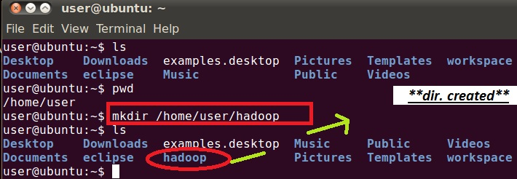
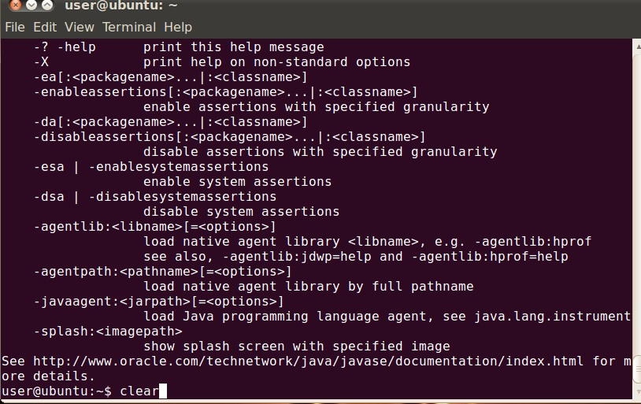
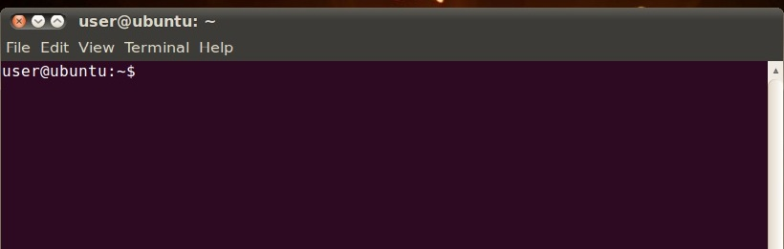
LINUX Structure & some basic commands (Cont..)
III. mkdir dir name : creating a file/folder .
IV. clear:- clears the terminal.

Slide 12
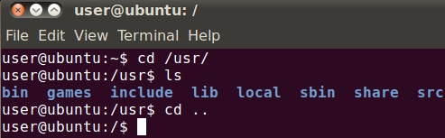
LINUX Structure & some basic commands (Cont..)
V. cd dest.name :- changing the directory

Slide 13
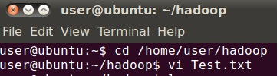
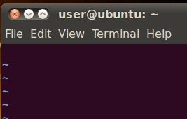
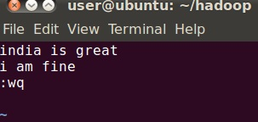
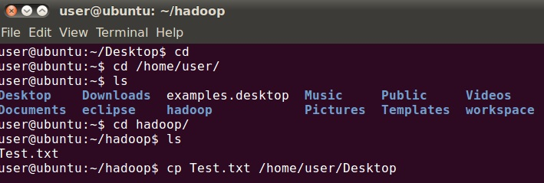
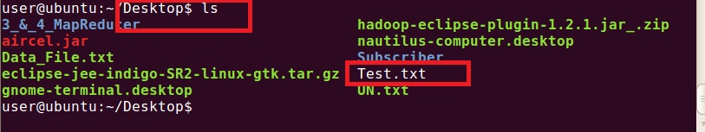
Creating, Copying & Deleting a file
Creating a File :-- for creating a file there are various editors available such as VI ,gedit.
Command: vi filename. extension
extension -- .txt,.sh
Copying a file:-- cp source dest. name

Slide 14
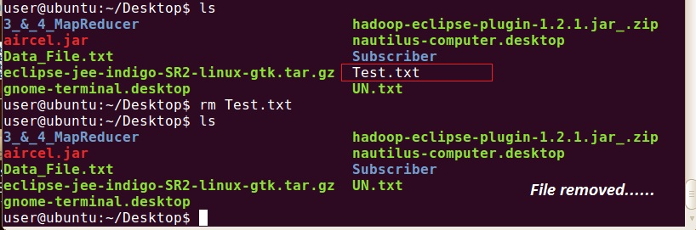
Creating, Copying & Deleting a file (Cont..)
To Delete a File : rm filename

Slide 15
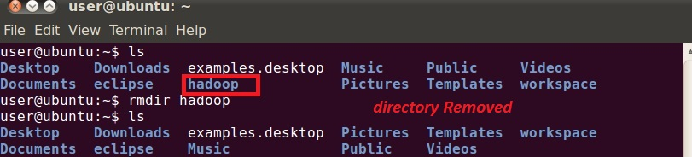
Creating, Copying & Deleting a file (Cont..)
rmdir filename : removing a directory

Slide 16
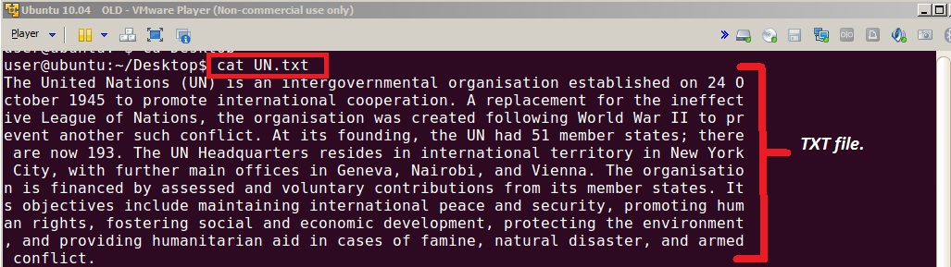
Creating, Copying & Deleting a file (Cont..)
cat command : It can be used for the following purposes under Linux:
Display text files on screen.

Slide 17
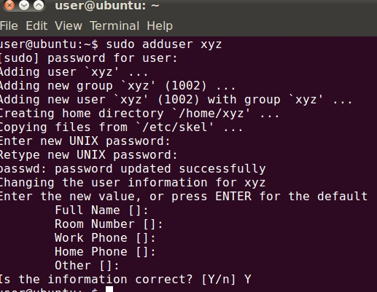
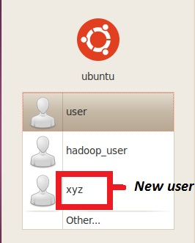
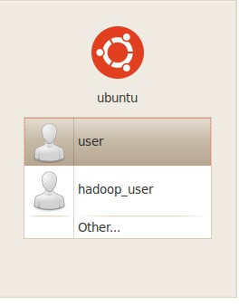
Creating, Copying & Deleting a file (Cont..)
Adding and removing new user:-- sudo adduser Newusename

Slide 18
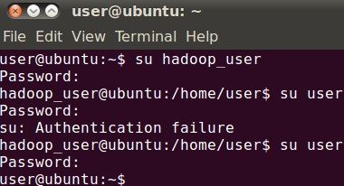
Creating, Copying & Deleting a file (Cont..)
Removing a User :-- sudo userdel Newusername..and the user will be deleted.
Switching to different user :-- su username.
then the required password of that user needs to be given.
Extracting a TAR file:
tar -zxvf yourfile.tar.
tar -xvf yourfile.tar

Slide 19
Assignments

Slide 20


Assignment 1
Ques 1: Display your current directory?
Sol: Type pwd
Ques 2: Change to the /etc directory?
Sol:
Ques 3: Now change to your home directory using only three key presses?
Sol:

Slide 21



Assignment 1 (Cont..)
Ques 4: Go to the root directory & list the contents of the root directory?
Sol:
Ques 5: Stay where you are, and list the contents of /bin and /sbin ?
Sol:

Slide 22
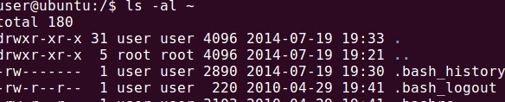
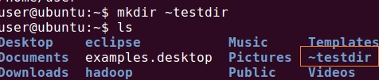
Assignment 1 (Cont..)
Ques 6: List all the files (including hidden files) in your home directory?
Sol:
Ques 7: Create a directory testdir in your home directory?
Sol:

Slide 23
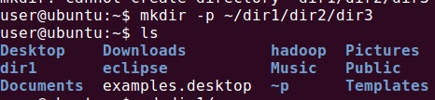
Assignment 1 (Cont..)
Ques 8: Create in one command the directories ~/dir1/dir2/dir3 (dir3 is a subdirectory from dir2,
and dir2 is a subdirectory from dir1)
Sol:
Ques 9: Remove the directory testdir
Sol:

Slide 24



Assignment 2
Ques 1: How to create a directory and entering files into it?
Sol:
Ques 2: Rename today.txt to hi ?
Sol:

Slide 25


Assignment 2 (Cont..)
Ques 3: Create a directory called testbackup and copy all files from HELLO into it?
Sol:
Ques 4: Use one command to remove the directory testbackup and all files into it?
Sol:

Slide 26
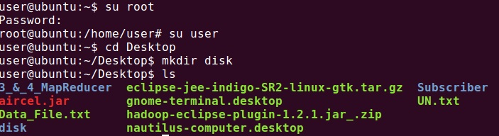
Assignment 2 (Cont..)
Ques 5: Switch to Root from normal user and vice-versa and create a directory on desktop?
Sol:
Ques 6: Check out your :-
Directory you created on Desktop by moving into it.
Create a sub directory as the fig given below under normal user.
Copy the No.of employee folder in to No of beds folder
Hospital
Branch
Wards
No of beds
No of Employee

Slide 27
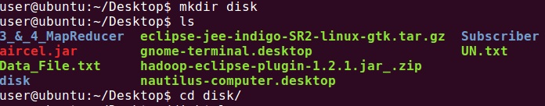
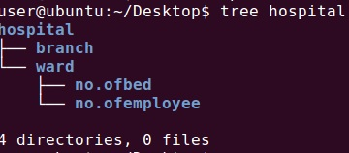
Assignment 2 (Cont..)
Sol:

Slide 28
Assignments as home Works
Ques 1: Make a file named Hadoop under a directory Project on Desktop?
Ques 2: Delete this file after copying it to another directory names yarn?
Que 3: Opening vi editor and typing something in it and saving it?
Ques 4: Opening a previously saved text file and edit using gedit?
Ques 5: Adding new user to Ubuntu?
Ques 6: Getting used to all the Commands told in the Session?

Slide 29
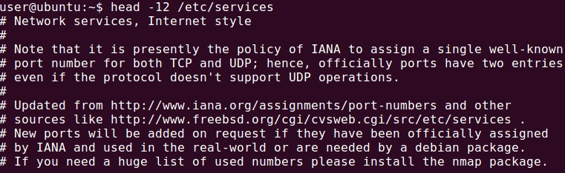
Commands Contd….
Ques 7: Display the first 12 lines of /etc/services.
Sol:
Ques 8: Display the last line of /etc/passwd ?
Sol:

Slide 30
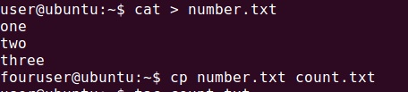
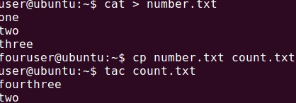
Commands Contd….
Ques 9: Use cat to create a file named number.txt that looks like this
Sol:
Ques 10: Use cp to make a backup of this file to count.txt. and Display count.txt, but with all lines in
reverse order (the last line first)?
Sol:

Slide 31
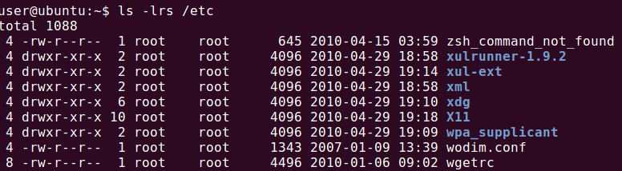
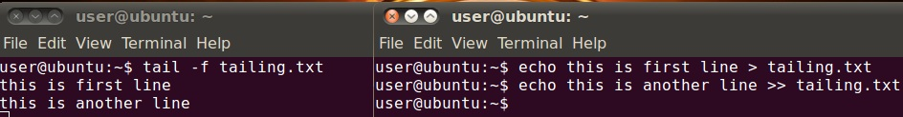
Commands Contd….
Ques 11: Use ls to find the biggest file in /etc ?
Sol:
Ques 12: Open two terminal windows (or tabs) and make sure you are in the same directory in both Type echo this is the first line > tailing.txt in the first terminal, then issue tail –f tailing.txt in the second terminal. Now go back to the first terminal and type echo This is another line >> tailing.txt (note the double >>), verify that the tail -f in the second terminal shows both lines. Stop the tail -f with Ctrl-C.
Sol:

Slide 32
Extra Quiz
Ques : Use cat to create a file named tailing.txt that contains the contents of tailing.txt followed by the contents of /etc/passwd.

